Slide 1
Anomaly detection
孙肖仪
2020.10

Slide 2
Paper list
KDD 2020: USAD : Unsupervised Anomaly Detection on Multivariate Time Series
KDD 2019: Deep Anomaly Detection with Deviation Networks
KDD 2017: Anomaly Detection in Streams with Extreme Value Theory

Slide 3
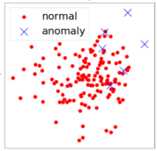
Background
What is anomaly detection?
Anomalies are referred to as data objects that deviate significantly from the majority of data objects
E.g.
network attacks in cybersecurity;
fraudulent transactions in finance;
unexpected behavior in IT service

Slide 4
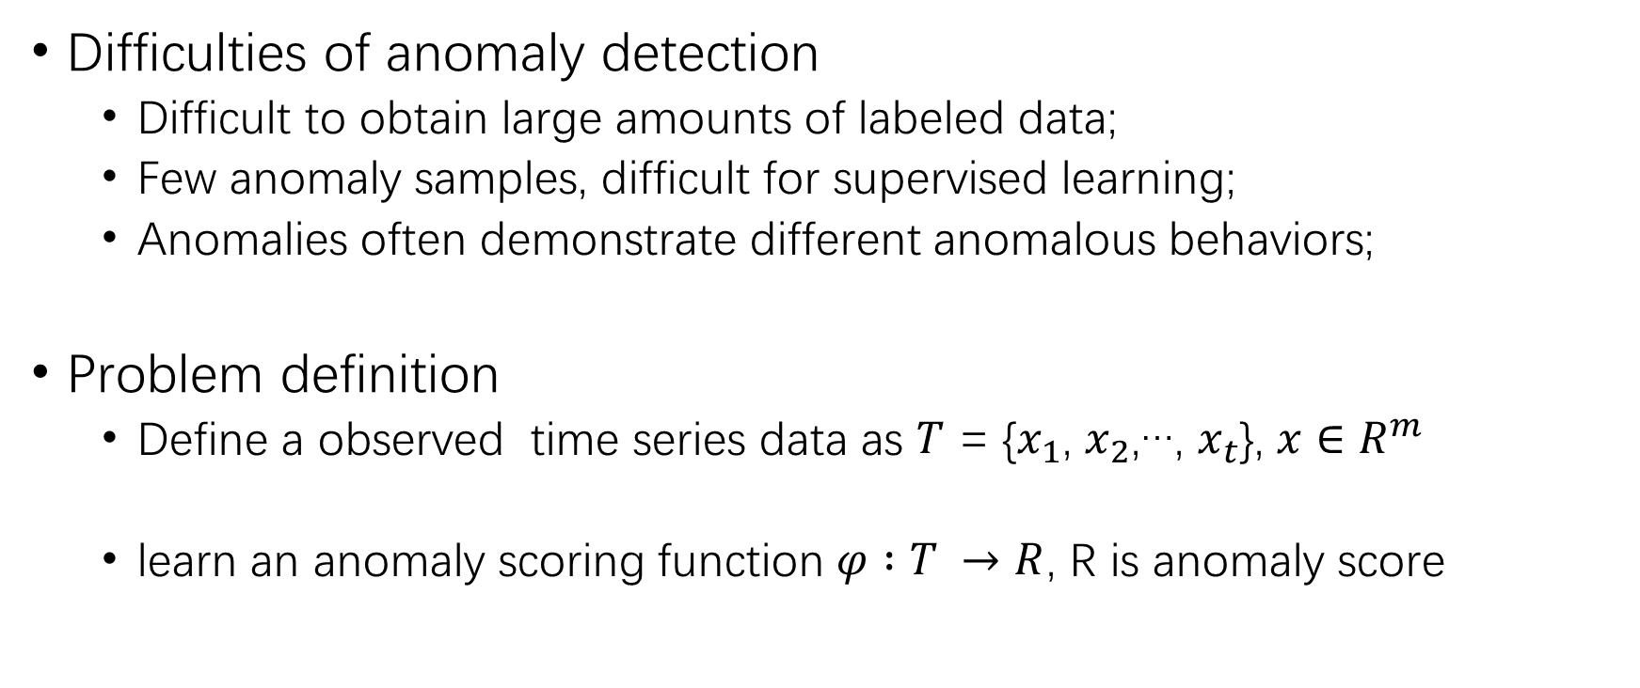
Background
Difficulties of anomaly detection
Difficult to obtain large amounts of labeled data;
Few anomaly samples, difficult for supervised learning;
Anomalies often demonstrate different anomalous behaviors;
Problem definition
Define a observed time series data as $T$ = {$x_{1}$, $x_{2}$,…, $x_{t}$}, $x∈R^{m}$
learn an anomaly scoring function $φ :T →R$, R is anomaly score

Slide 5
Background
Unsupervised anomaly detection methods
Prediction Models:
one-class SVM,
isolation forest
Statistic methods
Extreme value theory
Reconstruction error :
AutoEncoder (AE)
Variational AutoEncoder (VAE)
Generative Adversarial Networks (GAN)

Slide 6
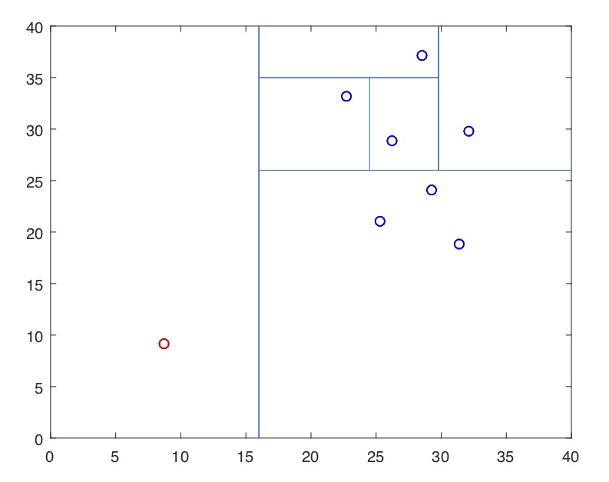
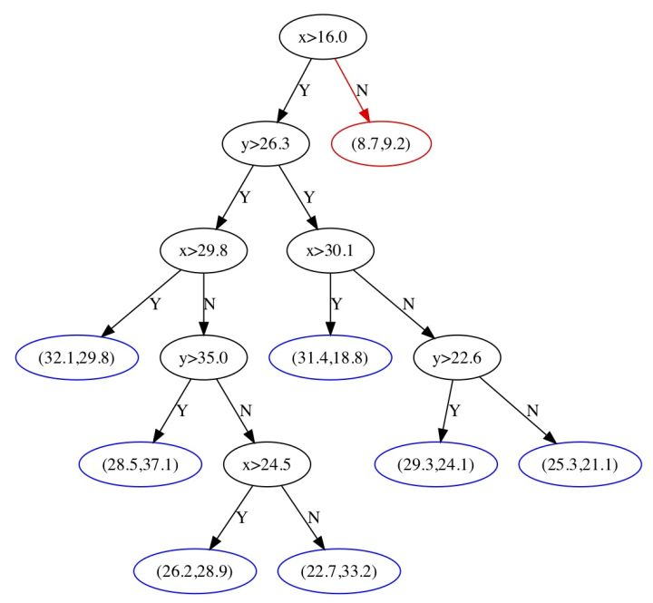
Background
Isolation forest
Anomaly is more likely to be separated
The shorter path in the decision tree has a higher anomaly score

Slide 7
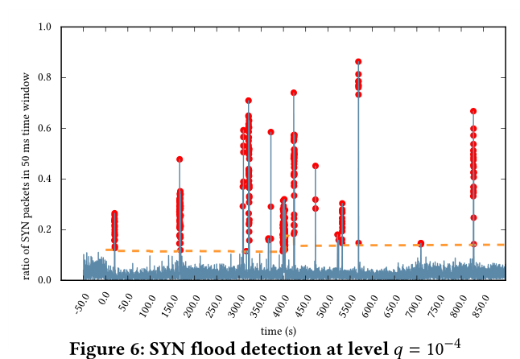
Anomaly Detection in Streams with Extreme Value Theory
Introduction
This Extreme Value Theory was developed to study the law of extreme values in a distribution function after the following dramatic event
The distribution of the extreme values is almost independent of the distribution of the data
Notes:
n the night of January 31 to February 1 of the year 1953, a set of rare conditions occurred in the North Sea, leading to a “perfect storm” scenario. On the coast of Netherlands, the waves
generated overwhelmed the dikes, causing extensive flooding. The flooding led to the death of 1800+ people in the Netherlands alone. Statisticians devised an elegant theory for the study of such rare events

Slide 8


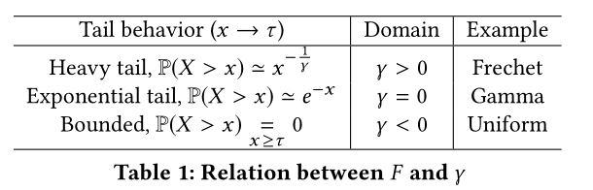
Method
Extreme value distributions
Form:
Peaks-Over-Threshold (POT) approach (second theorem in EVT)

Slide 9


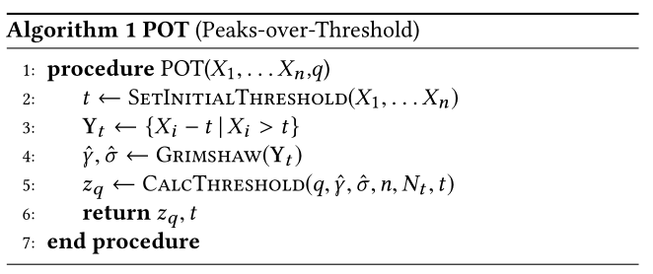
Method
Finding anomalies in a stream
Suppose X that is bigger than zq is an anomaly => to find out zq
Given a fixed risk q, such that
Maximum likelihood estimation to calculate parameters:

Slide 10
Background
Unsupervised anomaly detection methods
Prediction Models:
one-class SVM,
isolation forest
Statistic methods
Extreme value theory
Reconstruction error :
AutoEncoder (AE)
Variational AutoEncoder (VAE)
Generative Adversarial Networks (GAN)

Slide 11
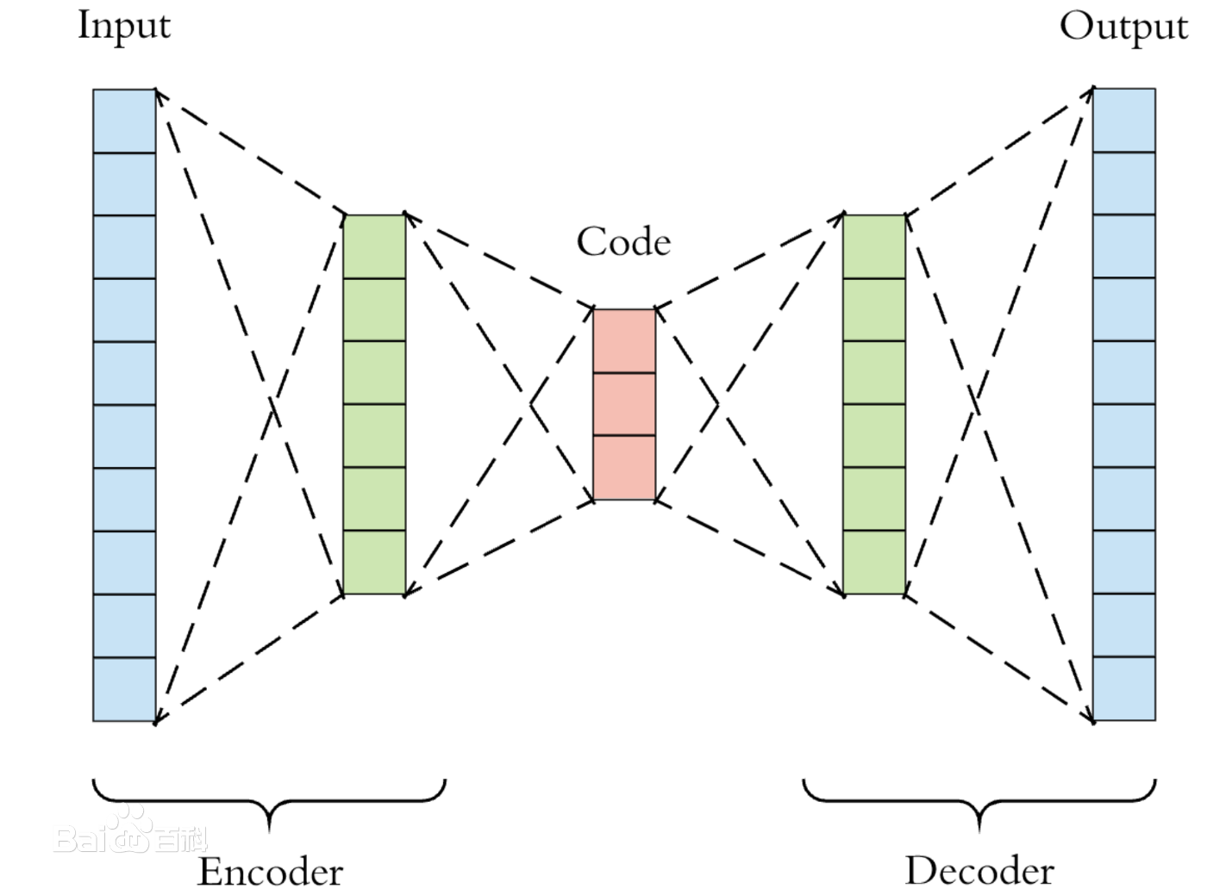
Background
AutoEncoder
AutoEncode the normal samples, anomaly samples are not learned
Compare the input and output, anomaly samples have high reconstruction error

Slide 12
Deep Anomaly Detection with Deviation Networks
Introduction
a limited number of labeled anomalies is often available in many real-world anomaly detection applications
This work leverages multiple to dozens of labeled anomalies, accounting for only 0.005%-1% of all training data objects and 0.08%-6% of all anomalies per data set

Slide 13
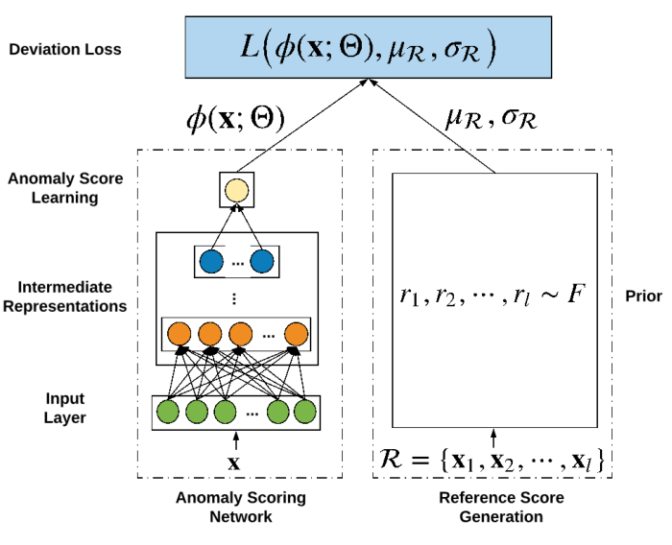
Method
Framework
an anomaly scoring network to yield a scalar anomaly score for every X
reference score generator to generate another scalar score termed as reference score
optimize the anomaly scores with uR

Slide 14
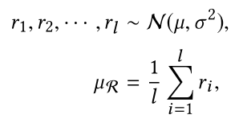
Method
Gaussian Prior-based Reference Scores
extensive results show that Gaussian distribution fits the anomaly scores very well in a range of data sets.
set µ = 0 and σ = 1 in the experiments

Slide 15

Method
Z-Score-based Deviation Loss
deviation loss function:
scores of anomalies statistically significantly deviate from µR in the upper tail
at the same time having the scores of normal objects as close as possible to µR

Slide 16
USAD : Unsupervised Anomaly Detection on Multivariate Time Series
Introduction
GAN training is not always easy, A production environment requires the development of robust methods that can be re-trained routinely.
This work propose a new method for multivariate time series based on an autoencoder architecture whose learning is inspired by GANs.

Slide 17
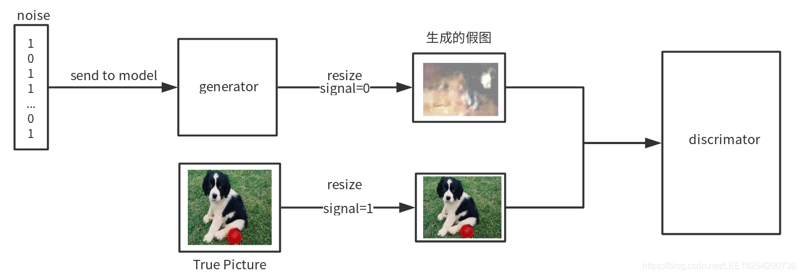
GAN

Slide 18
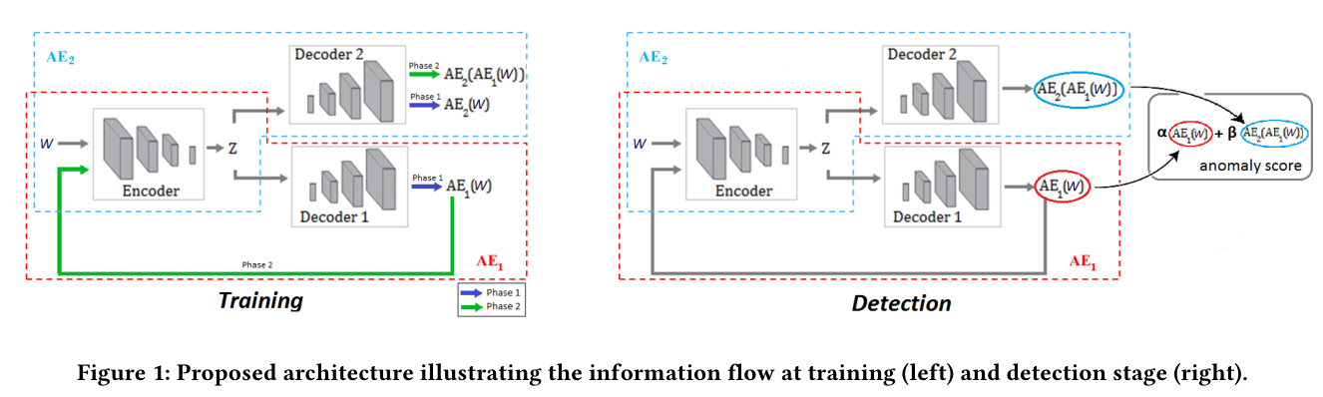
Method
Framework

Slide 19



Method
Phase 1: Autoencoder training
the training objectives are:
Phase 2: Adversarial training
AE1 trains on whether or not it succeeds in fooling AE2
AE2 distinguishes the candidates reconstructed by AE1 from the real data

Slide 20
Method
Inference
the anomaly score is defined as:
α + β = 1, If we α is greater than β , we reduce the number of true positives and false positives

Slide 21
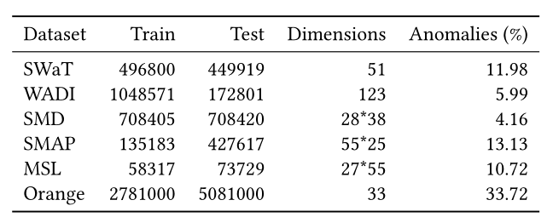
Experiment
Dataset
Extreme value theory
One dataset: MAWI repository which contains daily network captures
Deviation Networks
Five data sets contain real anomalies, i.e., exceptionally exciting projects in donors, fraudulent credit card transactions in fraud, back door network attacks in back door, malicious URLs in URL, and hypothyroid patients in thyroid.
The other four datasets contain semantically real anomalies, i.e., they are rare or very different from the majority of data objects.
USAD

Slide 22
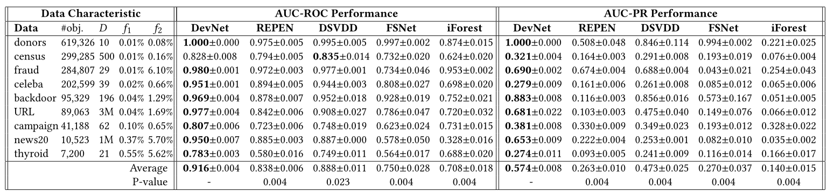
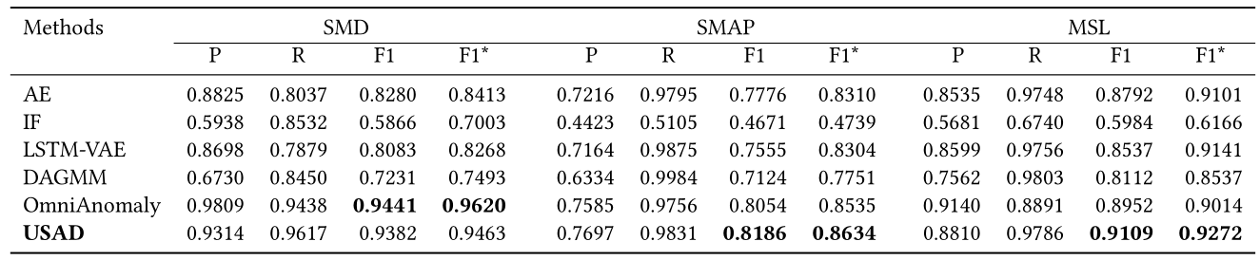
Experiment
Deviation Networks
USAD
Notes:
REPEN in deep anomaly detection with limited labeled data, DSVDD in feature learning for anomaly detection, FSNet in fewshot classification, and iForest in unsupervised anomaly detection.
Isolation Forests (IF) [ 10 ], autoen-coders (AE), LSTM-VAE: Variational Auto-Encode, DAGMM: Deep autoencoding Gaussian mixture model for unsupervised anomaly detection, OmniAnomaly: Robust anomaly detection for multivariate time series through stochastic recurrent neural network.

Slide 23
To conclude
Strength
Extreme value theory
Easy to verify and use, can be adopted to deal with simple scene with one attribute
Deviation Networks
Change the classification problem to the regression problem
Is more easy to train/avoid the imbalance problem
Leverages the few labeled data
USAD
An interesting architecture to replace GAN

Slide 24
To conclude
Weakness
Extreme value theory
Only target at one-dimension data, the bigger is more abnormal
Deviation Networks
The data X and the reference scores have no relationship
Two similar samples will not be referred to a close scores
The score distribution in man-made : related with data set
USAD
The loss function dubious, the algorithm has no mathematical proof
Why it is easier to train than GAN? No experiment comparison

